Slide 1
Global Supermarket Sales Overview
By-- Anish Kumar Gupta
PGDA 36

Slide 2
Table of Contents
Problem Statement
Analysis Objective
Dashboard 1
Insights
Forecasted Dashboard 2
Forecasted Insights
Interpretation
Forecasted Dashboard 3
Dashboard 3 insights
Future Expectations /Planning

Slide 3
Problem Statement
The problem statement addresses the key challenges faced by the Global Super Store. These challenges may include:
Sales Distribution: Identifying regions or segments where sales are not meeting expectations.
Return Orders: Understanding the high number of return orders (1,079) and their impact on overall profitability.
Delivery Efficiency: Analyzing the average delivery days (4 days) to ensure it meets customer expectations.
Customer Profitability: Identifying the most and least profitable customers to tailor marketing and sales strategies accordingly.
Product Performance: Evaluating the profitability of different products to determine which items are driving losses.

Slide 4
Analysis Objective
The primary objective of this analysis is to provide a detailed overview of the sales performance and operational metrics of the Global Super Store. This involves analyzing various dimensions such as sales figures, quantities sold, delivery efficiency, return orders, market segmentation, and customer profitability. The goal is to identify trends, highlight key performance indicators, and uncover areas that need improvement to enhance overall business performance.

Slide 5
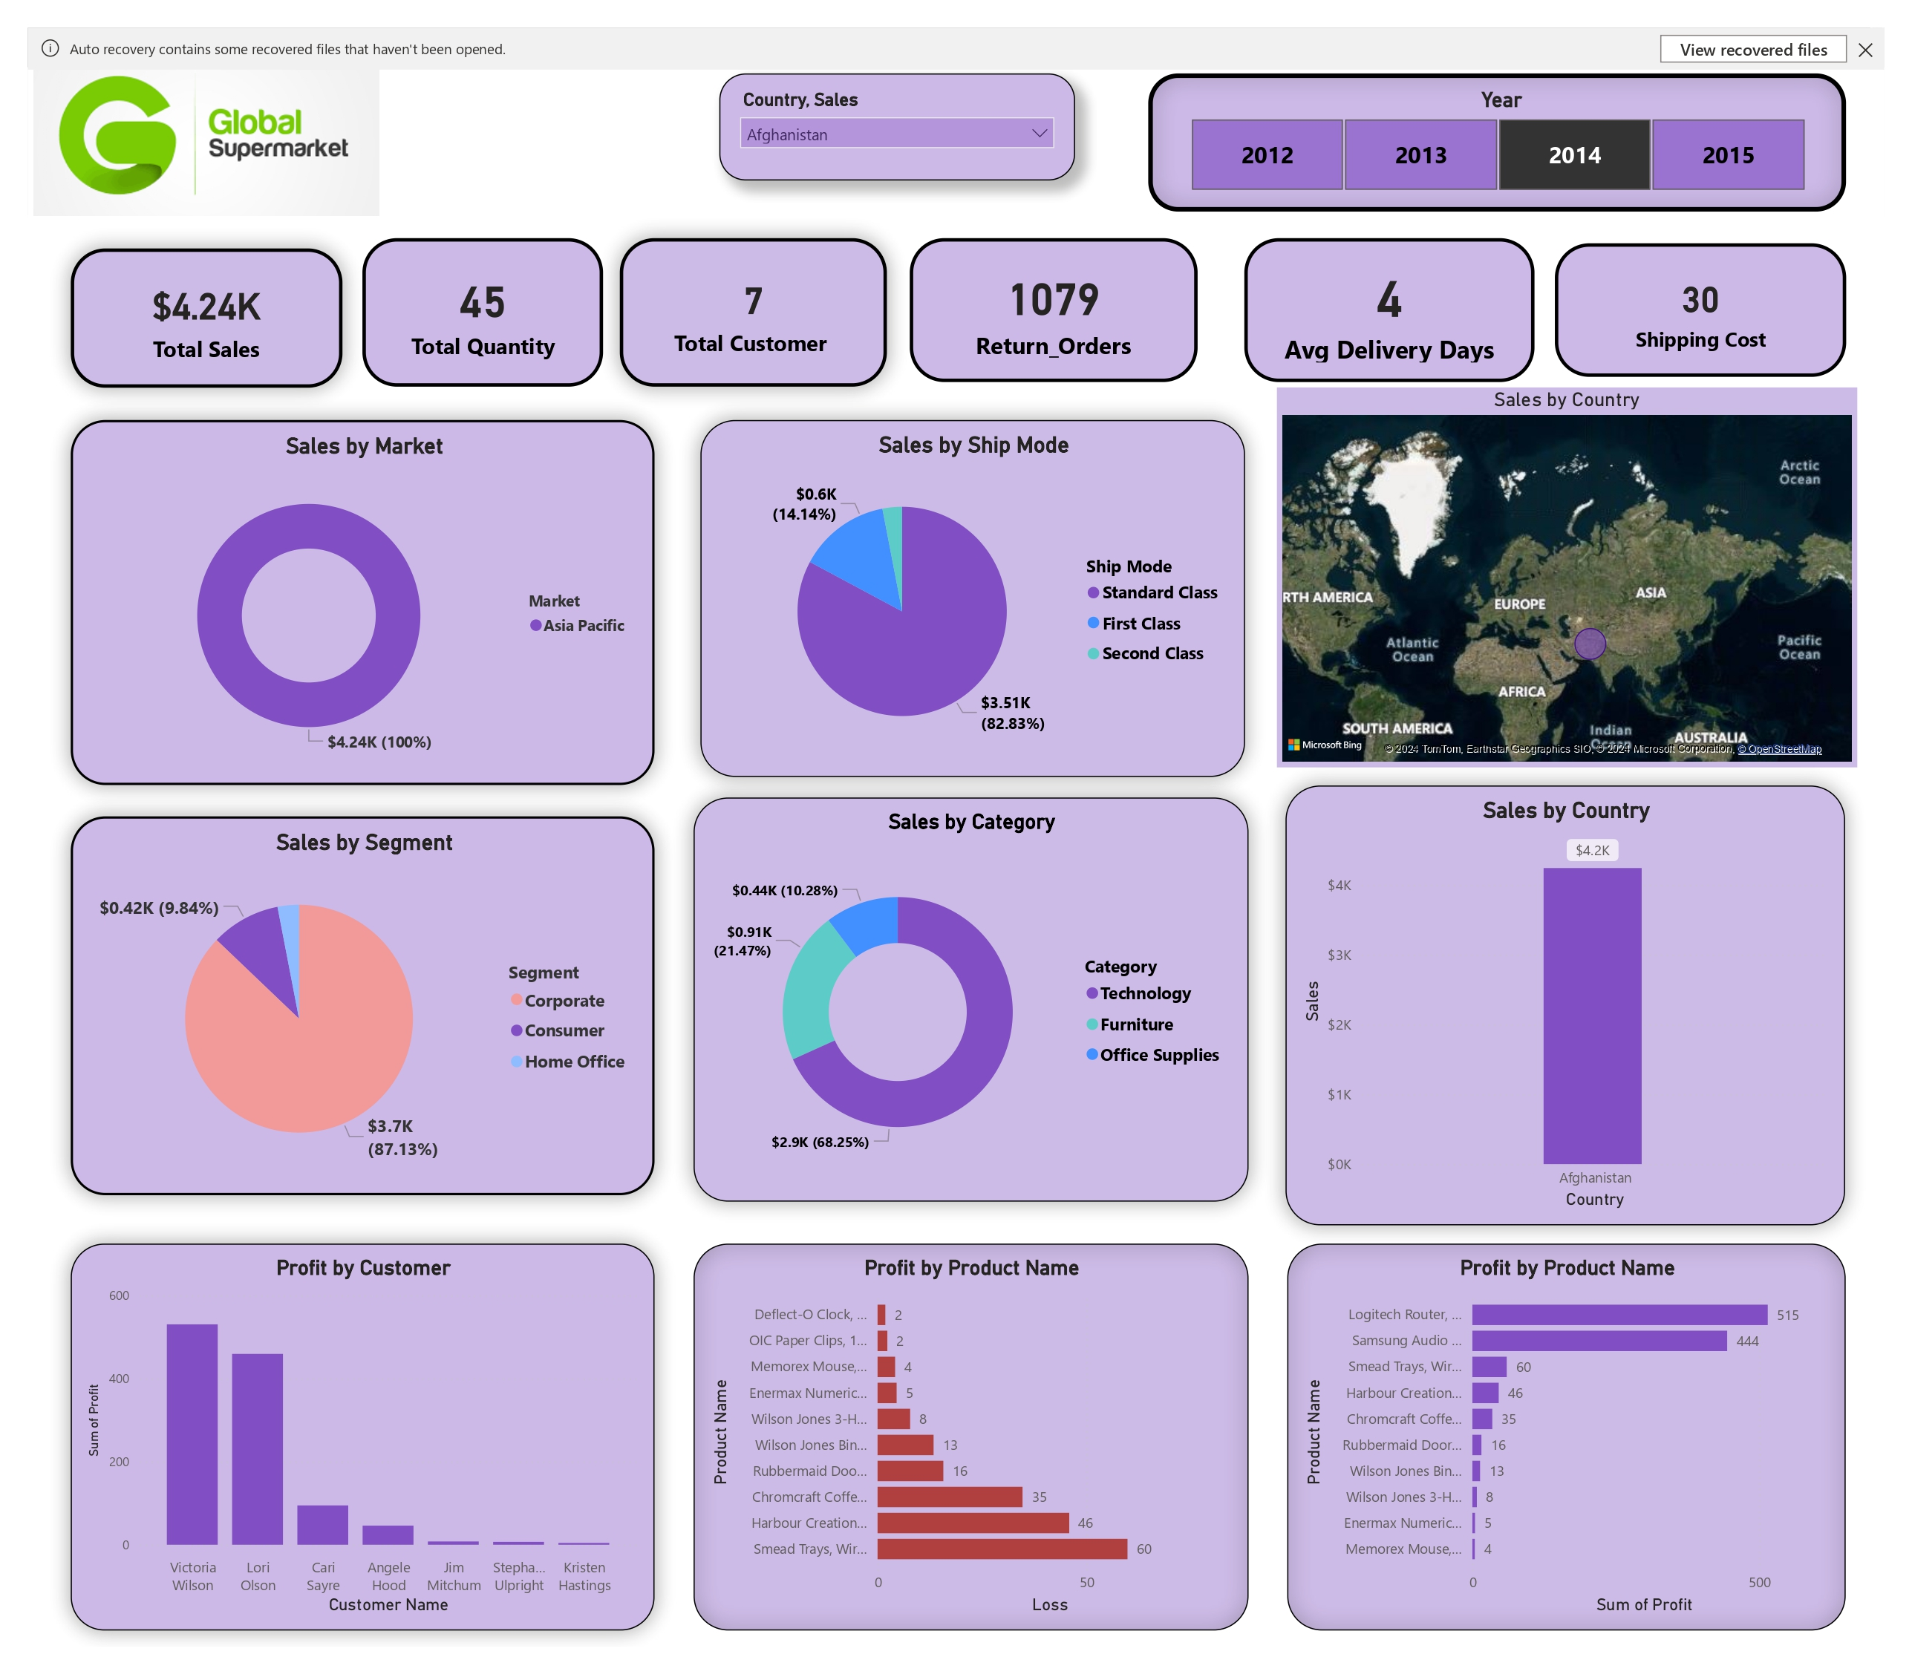

Slide 6
Insights
The analysis provides several key insights:
Sales by Segment: The majority of sales come from the Consumer segment, accounting for $3.7K (87.13%) out of the total $4.24K sales, with Corporate and Home Office segments contributing less.
Market Focus: All sales in the analyzed data are from the Asia Pacific market, indicating a strong presence or focus in this region.
Customer Profitability: The most profitable customers include Victoria Wilson and Lori Olson, while the least profitable ones include Jim Mitchum and Kristen Hastings.

Slide 7
Product Performance: The top-performing product is the Logitech Router, generating the highest profit. In contrast, the Deflect-O Clock is the least profitable product, contributing to the highest losses.
Sales by Category and Ship Mode: Technology is the leading category in sales, and Standard Class is the preferred shipping method, accounting for the majority of shipments.
These insights can help the Global Super Store to strategize on improving sales, reducing return orders, optimizing delivery times, and focusing on profitable products and customer segments.

Slide 8
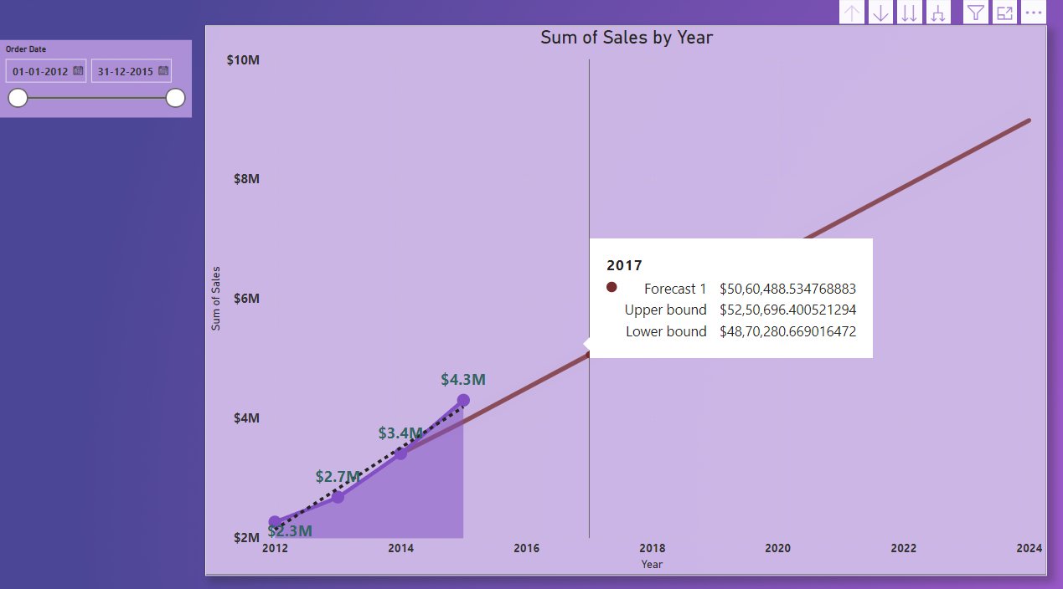
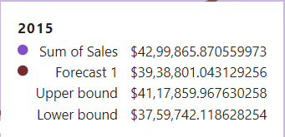
Forecasted of the Sales over the Year

Slide 9
Forcasted Insights The chart visualizes the sum of sales by year, with actual data points from 2012 to 2015 and a forecast extending from 2016 to 2024. Components Axes: X-Axis (Years): Spanning from 2012 to 2024. Y-Axis (Sum of Sales): Ranging from $2M to $10M. Historical Data Points: 2012: Sales were $2.3M. 2013: Sales increased to $2.7M. 2014: Sales further rose to $3.4M. 2015: Sales reached $4.3M. Trend Line: Dotted Line: This line connects the historical sales data points from 2012 to 2015, showing the growth trend over these years. Forecasting Line: Solid Line: Extends from 2015 through to 2024. This line is an extrapolation of the past sales data, indicating the expected sales if the historical growth trend continues. The forecast suggests a linear growth pattern, projecting that sales will reach approximately $10M by 2024.

Slide 10
Interpretation
OrderDate Filter: Located in the top left corner, this interactive element allows the selection of a specific date range. The filter in this case is set from January 1, 2012, to December 31, 2015, which is the period used for the historical data in the chart.
Historical Sales Growth: The chart shows a consistent increase in sales year over year from 2012 to 2015. This suggests a strong upward trend, indicating a healthy growth in sales during this period.
Forecasted Growth: The solid line projecting future sales suggests that if the same growth rate continues, the sales will keep increasing steadily. By 2024, sales are projected to reach $10M. This forecast can be useful for strategic planning, budgeting, and setting sales targets.
Assumptions: The forecast assumes that the factors contributing to sales growth from 2012 to 2015 will continue unchanged. No major market disruptions, economic downturns, or significant changes in business operations are considered.
Limitations: Forecasts based on linear extrapolation do not account for potential fluctuations or changes in the market environment. External factors such as competition, market saturation, and economic conditions can impact actual future sales. The forecast is only as accurate as the historical data and the assumption that past trends will continue.

Slide 11
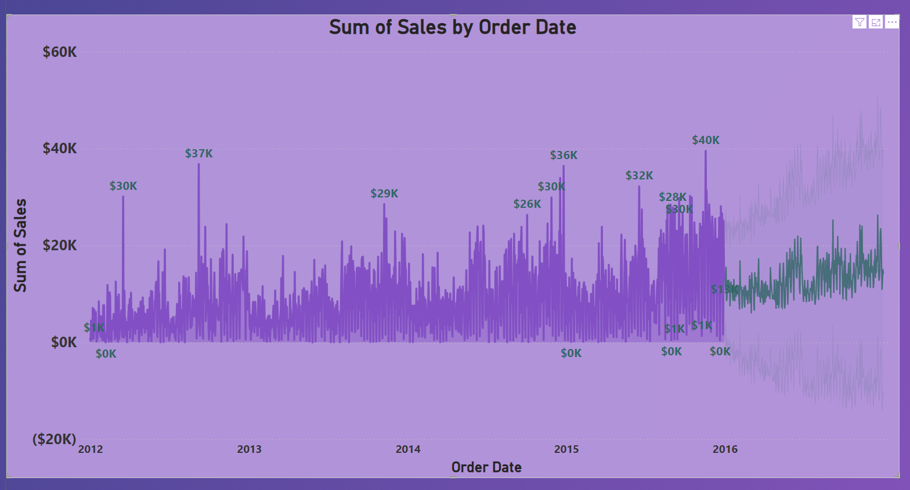

Slide 12
Historical Sales Data: The purple area represents historical sales data from 2012 to mid-2016. The data shows significant fluctuations, with several highlighted peaks indicating notable sales values.
Forecasting: The forecasted sales are shown as a continuation of the historical data beyond the mid-2016 mark. The forecasted data appears in a lighter purple shade, indicating predicted future sales. The forecasting line suggests a general upward trend in sales, which aligns with the overall increasing trend observed in the historical data.
Highlighted Points: Specific points on the forecast line are highlighted with values such as $1K and $0K, indicating notable forecasted sales values.
Trends and Patterns: The forecast line maintains the pattern of fluctuations observed in historical data, suggesting that the model used for forecasting incorporates historical volatility. The upward trend in the forecast indicates expected growth in sales, which could be due to seasonality, market conditions, or other factors considered in the forecasting model.
Axes and Labels: The y-axis (Sum of Sales) ranges from negative values to $60K, covering both historical and forecasted data. The x-axis (Order Date) extends beyond mid-2016, showing the time period for which the forecast is made.
Visual Representation: The forecasted data is visually distinguishable from the historical data, allowing viewers to easily see where historical data ends and forecasted data begins. The use of color and shading effectively differentiates between actual and predicted values.

Slide 13
Future Expectations/Planning
Business Planning: Companies can use such forecasts for strategic planning, setting sales targets, and resource allocation.
Performance Monitoring: Comparing actual future sales against the forecast can help in assessing the accuracy of predictions and adjusting strategies accordingly.
Investor Communication: Forecasts provide investors with a glimpse of potential future performance, aiding in investment decisions.
In summary, the visual combines historical sales data with a forecast, showing a predicted upward trend in sales. The forecast is presented as an extension of the historical data, maintaining similar patterns and highlighting key predicted values. This approach allows for a clear comparison between past performance and expected future outcomes.

Slide 14
Thank you

